Slide 1
METRONOME × REPLICATE · PARTNERSHIP SESSION
Billing that ships
as fast as your GPUs.
Ten minutes of context, then thirty minutes inside your pricing,
your free trial, and your enterprise contracts — running on Metronome.
Prepared by the Metronome strategy team · October 2026
Notes:
PURPOSE: Set the frame in 45 seconds — this is a working session about Replicate's billing, not a vendor pitch. The title is the whole thesis: their GPU roadmap moves fast; billing must move at the same speed.
EMPHASIZE: Pause after the title line and let it land; then the agenda (10 min talk, 30 min demo, everything shown is config).
TONE: Confident, calm, peer-to-peer. No hype — senior engineers in the room.

Slide 2
WHY WE ARE HERE
50k+
Every model run
is a billing event —
rated, credited, invoiced.
open-source models behind one API
30,000
paying customers — 2M+ developers signed up
You rebuilt model deployment as one API call. The monetization layer underneath it — SKUs, trials, commits, invoices — is still homegrown.
That gap is what we are here to close today.
$40M
Series B — a16z, NVIDIA, Sequoia, YC (Dec 2023)
Sources: replicate.com/blog/series-b; replicate.com/pricing; blog.cloudflare.com/replicate-joins-cloudflare; third-party estimates (FourWeekMBA, 2025). Scale figures are directional.
Notes:
PURPOSE: Show we did the homework — anchor Replicate's scale with their numbers before we talk about ourselves. Builds the right to have an opinion.
EMPHASIZE: The punchline on the right: "every run is a billing event." That sentence converts their growth story into the billing problem. Numbers are third-party estimates + their Series B post — say so out loud.
TONE: Admiring, factual. Genuinely complimentary about the business; precise about sources.

Slide 3
WHAT YOU TOLD US
1
"Adding another machine type takes two engineering teams — it can take weeks."
Billing gates the
hardware roadmap
2
"We measure trial credit usage once a day. Users run far past it before we ask for a card."
GPU cost bleeds on every
leaky trial, every night
3
"Our billing can't model fixed or percent-based fees — so we have no support tiers."
Enterprise demand
goes unmonetized
4
"We can't tell customers where they are against a $100k commit without an engineer querying the database."
Renewals fly blind;
engineers get interrupted
Four frictions, one root cause: pricing logic lives in code —
and every pricing question becomes an engineering ticket.
Notes:
PURPOSE: The emotional low point of the deck — their four pains, in their own words, with the business cost attached. We read these back to them; heads should nod. This slide is the contract for the whole demo: every act answers one of these.
EMPHASIZE: Read each quote verbatim and attach the cost line. On #1, ask the discovery question: "Which two teams, and what does that calendar look like?" — then stop talking.
TONE: Empathetic, never gloating. These are the natural scars of a company growing this fast.

Slide 4
WHERE METRONOME SITS
REPLICATE
METRONOME
Stripe — paygo
Prediction service
runs · fine-tunes · deployments
emits
gpu_inference
{hardware, billed_seconds}
Meter & rate per second
Credits, commits, trials
Contracts & overrides
Support fees — flat & %
Real-time balances
Alerts & webhooks
Draft & final invoices
card collection, self-serve invoices (Metronome is now part of Stripe)
events
NetSuite — enterprise
invoices & ASC 606 revenue recognition
Salesforce — CRM
commit balance & usage synced to the account
One rating engine between your product and your money systems —
and your engineers stop being the billing department.
Notes:
PURPOSE: Answer "what is Metronome and where does it sit in OUR stack?" in one diagram — the marketecture the agenda asks for. Left: their world (prediction service). Middle: Metronome as the rating & contract engine. Right: the exact systems they named — Stripe, NetSuite, Salesforce.
EMPHASIZE: The arrow direction and the sentence "your engineers stop being the billing department." Point out Metronome is now part of Stripe — their existing paygo rail.
TONE: Clear, technical-but-plain. Slow down here; this is the mental model everything else hangs on.

Slide 5
WHO ALREADY RUNS ON METRONOME
OpenAI · Anthropic · NVIDIA · Databricks · Confluent
10+
$1B
pricing changes shipped by OpenAI in 12 months —
no billing-code deploys
Stripe's acquisition of Metronome, closed Jan 2026 —
the paygo rail you already use
Billions of usage events rated every month. 100k+ events per second at ingest.
Sources: TechCrunch (Jan 2024); Stripe blog (Jan 2026); Metronome re:Invent 2025 session AIM109.
Notes:
PURPOSE: Belief. After the pain and the model, prove this is safe ground: the companies Replicate respects already run here, at volumes beyond Replicate's, and Stripe put $1B behind the platform.
EMPHASIZE: Two numbers only — "10+ pricing changes in 12 months" (OpenAI, the Pain #1 rebuttal) and the Stripe acquisition (their existing rail, de-risked). Name the peer logos slowly; NVIDIA is both their investor/supplier and a Metronome customer.
TONE: Understated. Let the names carry it; no chest-beating.

Slide 6
YOUR PAINS → WHAT YOU WILL SEE
YOUR PAIN | METRONOME CAPABILITY | DEMO
Weeks + two teams to add a machine type | Pricing as config — one dimensional rate row per SKU, scheduled, ops-owned | Act 1 · 6′ rate card, live
Daily trial-credit measurement; silent overruns | Real-time balances; threshold alerts at 25% / 3 days / $0; webhooks on ingest | Act 2 · 7′ trial, end to end
No fixed or %-based fees → no support tiers | Subscription (flat $/mo) + Composite (% of spend) products, entitled per contract | Act 3 · 4′ both fee shapes
Commit balances need an engineer + a SQL query | Commits with live drawdown; customer-facing dashboard; Salesforce sync; 80% alert | Act 4 · 7′ $100k / 3yr deal
Act 5 · 4′ — Stripe · NetSuite · Salesforce, without the glue — your existing stack, synced.
Notes:
PURPOSE: The bridge slide — one table that maps every pain to the exact capability and to the demo act that proves it. This is the slide the customer judges "quality of content" on; it is also the safety net if the demo is interrupted.
EMPHASIZE: Row 1 and row 4 (their most-quoted pains). Preview the mapping in one breath per row; don't read cells.
TONE: Crisp, organized, brisk — this slide buys back time for the demo.

Slide 7
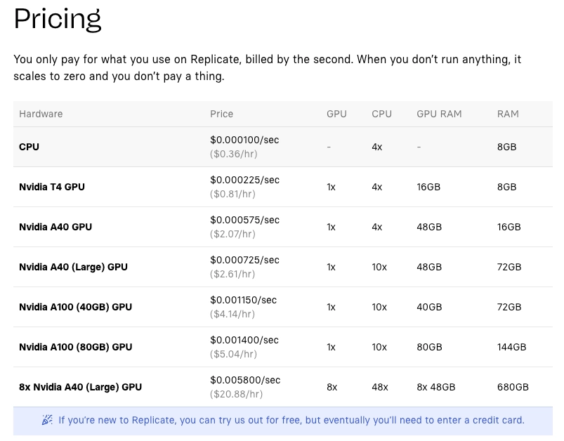
YOUR PRICING — ALREADY MODELED
HARDWARE | $ / SEC
cpu | 0.000100
t4 | 0.000225
a40 | 0.000575
a40-large | 0.000725
a100-40gb | 0.001150
a100-80gb | 0.001400
a40-large-8x | 0.005800
h100 | 0.001525
replicate.com/pricing — today
the same table, as Metronome rate rows
Machine type #8 — the H100 — became a rate row.
Not a two-team, week-long project.
Notes:
PURPOSE: The teaser that makes engineers lean forward before the demo: their actual pricing page on the left, the same thing as Metronome config on the right. The H100 point lands the whole Pain #1 argument before we even open the product.
EMPHASIZE: The caption — "machine type #8 became a rate row." If the room only remembers one sentence from the slides, this is it.
TONE: Playful confidence. This is the "ta-da" slide; enjoy it.

Slide 8
THE ASK — A SCOPED PILOT
Two flows, your event stream,
one sandbox — 2–3 weeks.
W1
Self-serve trial, live — your gpu_inference events, $25/14-day credit, real-time alerts wired to your app; measure time-to-card-prompt in seconds, not days.
W2
One enterprise commit, visible — a real $100k/3yr deal re-created with ramp, discount, rollover; AE reads the balance in Salesforce, customer reads it in your product.
W3
Ship a SKU as config — your team adds the next machine type themselves; target under one hour, zero engineering involved.
Success criteria: trial-exhaustion signal in < 60 seconds · commit balance visible without an engineer · new SKU live < 1 hour.
Sandbox access and writer-token setup handled by Metronome; no production data required for the pilot.
Notes:
PURPOSE: The ask — a concrete, low-risk pilot with success criteria, so the meeting ends in a decision, not a "let's circle back." Scoped to the two flows that hurt most: the trial and one enterprise commit, in a sandbox, on their own event stream.
EMPHASIZE: The timeline (2–3 weeks) and the two success criteria — measurable, theirs. Ask directly: "Which pain do we make disappear first?"
TONE: Direct, warm, action-oriented. This is the close of the deck — no hedging.

Slide 9
OVER TO THE DEMO
Which of the four frictions
do we make disappear first?
Metronome strategy team
Demo guide & setup scripts accompany this deck.
Notes:
PURPOSE: Close the slides and hand over to the demo with one question hanging in the air. Also the slide to return to at Q&A.
EMPHASIZE: The question itself — ask it, then stop. Let them answer; their answer IS the pilot scope.
TONE: Quiet confidence, genuine curiosity. End of broadcast mode; beginning of working session.

